Slide 1

Edinburgh Business School MBA
AUC Academic Partner
Strategic Planning
Module 4
The Company and the Economy
Instructor: Moataz Darwish, MBA

Slide 2
Contents
4.1 The Company in the Economic Environment
4.2 Revenue and Costs: The Basic Model
4.3 The Workings of the Economy
4.3.1 Understanding and Using Economic Information
4.3.2 Supply and Demand in the Economy
4.3.3 Unemployment and Inflation
4.3.4 The International Economy
4.4 Forecasting: What Will Happen Next?
4.5 PEST Analysis
4.6 Environmental Scanning
4.7 Scenarios
4.8 The Economy and Profitability
4.8.1 Implications for Company Sales and Revenues
4.8.2 Competitive Reaction and the Economic Environment
4.8.3 Implications for Inputs and Company Costs

Slide 3
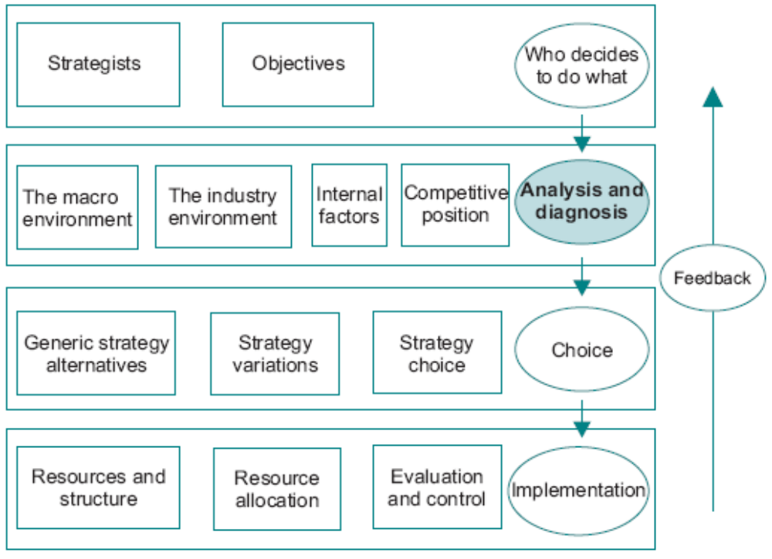
The Model

Slide 4
Lincoln quote during the civil war
I don’t claim to have controlled events but confess plainly that events have controlled me.

Slide 5
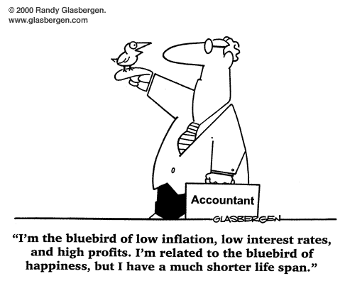
Introduction

Slide 6
The Company in the Economic Environment
Systematic view involves much more than general awareness.
Environmental Scanning provides information which can be used to construct (PEST) review of the environment and (ETOP).
In the face of this quantity of information:
  identify important variables,
  simplify them as far as possible,
  and subject them to appropriate analyses.
Notes:
Environmental scanning external and internal

Slide 7
Revenue and Costs: the Basic Model
Economy-wide changes can have significant effects on revenues and costs.
The model is constructed by identifying the variables which determine revenue and costs and determining the factors which affect these variables.
Revenue = Total Market x Market Share x Price
Outlay = Number of Workers x Wage Rate
+ Units of Capital x Price
+ Units of Material x Price
A sensible interpretation of macroeconomic factors can prevent the company from undertaking strategic moves too early.

Slide 8
Revenue and Costs: the Basic Model
The factors affecting the variables are numerous:
  Total Market: Population, Total Income, Preferences, Competing Products, Product Life Cycle
  Market Share: Price, Marketing Expense and Strategies of self and competitors
  Price: Demand Conditions, Segmentation, Competitive Reaction
  Workforce: Labour market, Regional Supply, Wage Rate, Work Conditions
  Wage rate: labour market conditions, unemployment rate.
  Capital: Capacity of the Goods Sector
  Capital Price: Capital Market Conditions
  Materials: Capacity of Suppliers
  Materials Price: Materials Market Conditions

Slide 9
Revenue and Costs: the Basic Model
Comprehensive picture of company performance.
Applied to those which it might produce in the future.
Dependent to some extent on the general state of economic activity.
Determines the behavior of the economy as a whole.

Slide 10
The Workings of the Economy
There are several reasons for analyzing and attempting to understand the economy.
Mangers, their attitudes and management styles can be greatly affected by general economic conditions.
The problem facing the manager is:
  to decide which information is relevant,
  interpret it in order to form a view on what is happening in the economy as a whole.

Slide 11
UK Economic History
50’s | 60’s | 70’s | 80’s | 90’s
Stable prices , Growth rates, Unemployment rates and inflation rates. (World-wide Phenomenon) |  | No training activities , Management ideas was alien concept ( Oil prices, Collapse of Bretton Woods) Fiscal Approach | Thatcher Era, Privatization and deregulation | Bubble burst, economic downturn, Slow progress recovery

Slide 12
Understanding and Using Economic Information
An overall impression of the level of economic activity can be obtained from general economic indicators such as:
  Unemployment rates,
  Industrial output,
  consumer spending.

Slide 13
Understanding and Using Economic Information
A consensus when the economy is in a boom or a slump.
Economic information must be interpreted in the context of current conditions.
‘Boom’ economy had strategic implications for companies in depending on which markets they were operating in.
It is not necessary for managers to have a detailed understanding of how the statistics were arrived at in order to derive strategy implications.

Slide 14
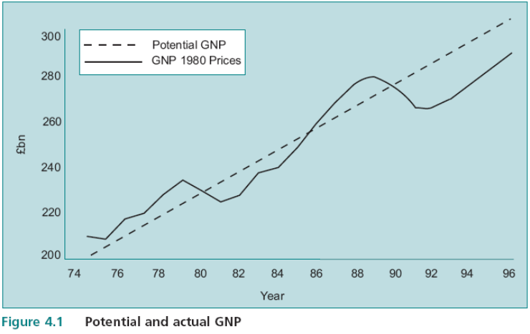
Supply and Demand in the Economy
The total value of goods and services produced in one year is known as Gross National Product (GNP).
National Product (GNP).The total output which the economy could produce if labour is fully employed and there was no excess capacity is known as potential or full employment GNP.
Actual output is not necessarily equal to potential output.
Actual output exceeds potential when there is labour shortage and overtime – consumption is above what the economy is capable of producing.

Slide 15
Supply and Demand in the Economy
When potential output > actual
  Unemployment is high
  Inflation is low
When potential output < actual:
  Unemployment is low
  Inflation is high
Unemployment can increase while actual output increases – depending on the relative rate of growth of potential and actual output. This relationship between unemployment rate and the output gap is not exact because of changes in definition of unemployment.

Slide 16
Supply and Demand in the Economy
Unemployment is comprised of 3 elements:
  Structural unemployment
  Frictional unemployment
  Demand related unemployment
This simplified approach to the behaviour of the economy using actual and potential output coupled with the different types of unemployment gives a basis to assess the likely impact of government policy measures.

Slide 17
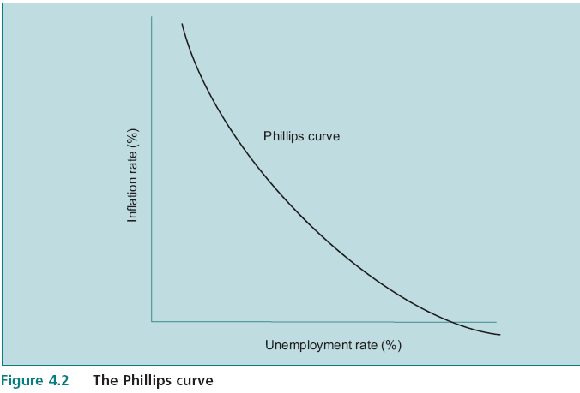
Unemployment and Inflation
In market economies: near full employment, wage rates, capital costs and material prices increase.
On the other hand, when there is significant unemployment, wage rates should decline but rarely do.
When demand grows faster than supply, prices go up (inflation) - too much money chasing too few goods
  A reasonable proposition is that:
    the lower the unemployment rate,
    the higher the wage inflation rate (Phillips curve).
    Usually it is expressed as a relation between unemployment and inflation.

Slide 18
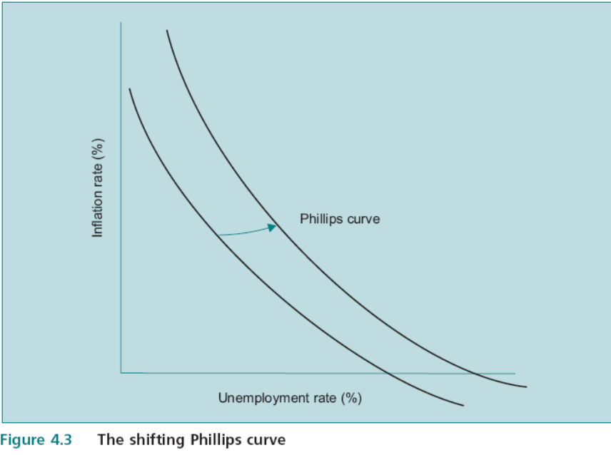
Unemployment and Inflation
Stagflation:
  One explanation is that the curve moved due to expectations that current inflation would continue. Hence unemployment stayed high.
  Policy was then to shift back Phillips curve – by eliminating the expectation of continuing inflation. How :
    By maintaining growth of money supply constant This is the “monetarist” approach.
    Increase unemployment rate and wait until inflation fell.
    Monetarist approach advantage is to avoid high cost of unemployment.
The implication is that inflation can only be countered with high unemployment – the effect of constant money supply takes longer.
The lesson for managers is that once prices increase caused by excess demand, it will take time for wage inflation rate to fall.
This can have important implications for the timing of the company’s strategy.

Slide 19
The International Economy
Companies are affected by the international factors – exporting, importing products or raw materials, competing in internal markets with importers …etc.
Relative Inflation Rates - which are not reflected in the exchange rates – affects costs and prices.
Export and FDI decisions may be impacted by these forces.
Exchange Rates Fluctuations – not determined by Balance of Trade but by international capital flows (80 times real trade flows !)
The factors affecting capital flows are – relative interest rates and expectations.
While difficult to plan accurately, scenario planning allows for contingencies.
Some companies argue they are not in the forex business - these will miss an opportunity to hedge some risks.
While it will not be possible to cover future exchange rates entirely, currency risks should be identified as any other risk and incorporated in the decision-making.

Slide 20
The International Economy – Diamond Model
The Competitive Advantage of Nations
Domestic factor conditions
Related and supporting industries
Demand conditions
Strategy, structure and rivalry
Porter identified ways in which a nation can affect competitiveness of a company:
  A firm’s home nation plays a critical role in shaping managers’ perceptions about the opportunities that can be exploited by supporting the accumulation of valuable resources and capabilities and creating pressures on the firm to innovate, invest and improve over time.
  The impact of the history and environment of a country is often obvious.
  Ex. Scotland vs. Singapore
  can offer favorable factor conditions, in particular those that are highly specialized to the needs of particular industries.
  can also offer favorable demand conditions in the form of sophisticated home consumers who continually force firms to produce the right things.
    Dangers of protectionism is that local companies have little incentive to retain competitive advantage (ex India’s auto industry, Eastern Bloc economies)

Slide 21
The International Economy – Diamond Model
When assessing its international competitive position, a company needs to determine whether its competitive advantage is due to country specific or company specific attributes - fundamentaly important in exploiting foreign markets.
  If the advantage is country specific then foreign markets can be exploited by exporting. This is because the impact of the national environment discussed above which will become apparent in a cost advantage.
  If the advantage is company specific it can invest in the country concerned provided that these advantages can be transfered from one country to another. This partly explains why Japanese car makers invested heavily in Britain: their management skills and production techniques were company specific and hence transferable.
Exchange rate uncertainty can influence locational decisions because producing in the country where the company sells its products insulates it from potentially unfavorable exchange rate movements. Decision makers thus have to trade off perceived competitive advantages against exchange rate risks.

Slide 22
Contents
4.1 The Company in the Economic Environment
4.2 Revenue and Costs: The Basic Model
4.3 The Workings of the Economy
4.3.1 Understanding and Using Economic Information
4.3.2 Supply and Demand in the Economy
4.3.3 Unemployment and Inflation
4.3.4 The International Economy
4.4 Forecasting: What Will Happen Next?
4.5 PEST Analysis
4.6 Environmental Scanning
4.7 Scenarios
4.8 The Economy and Profitability
4.8.1 Implications for Company Sales and Revenues
4.8.2 Competitive Reaction and the Economic Environment
4.8.3 Implications for Inputs and Company Costs

Slide 23
Forecasting: What Will Happen Next?
Trying to ascertain what is likely to happen.
Even vague predictions can be valuable
Direction of change is important in its own right;
  it may be possible to go further and predict the dimension of change,
  Predicting an increase or a decrease is the major determinant of strategy.
One problem facing managers is the number of forecasts available.
Can any use be made of these forecasts?
  The simple answer is no
Forecasters seem to share the ability to miss really big changes

Slide 24
Approaches to Forecasting
Number of approaches to forecasting, ranging from the intuitive to the highly quantitative:
  Discover one statistic which serves as a reasonable indicator of what is likely to happen next - leading indicator
    Ex. number of housing starts - glazing industry
    No one can predict when a leading indicator is likely to lose its predictive power.

Slide 25
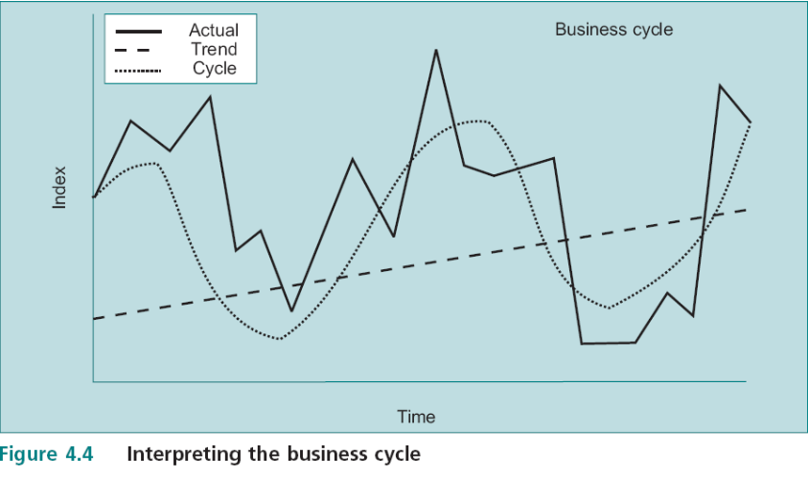
Approaches to Forecasting
  2. One approach is to think in terms of the business cycle – series decomposition
    Cyclical pattern of boom & depression
      3 components: general trend over time, the underlying smooth cycle, and random fluctuations.
What is the trend?
Ex. “long term growth rate in potential output”
What is the underlying cyclical pattern?
What random influences are likely to be disturbing the trend?

Slide 26
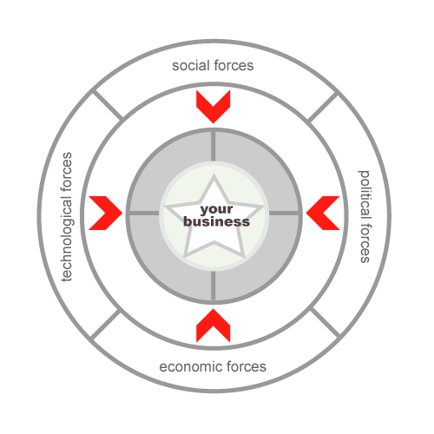
Macro-environment
Forecast
Short-term
PEST
What is likely to happen
Scenarios
Long-term
Present
Env Scanning
Likely Impact on
Future+wider range variables
Sales and revenues (purchasing Power)
Competitive Reaction
I/P costs (wage rates & investment costs)

Slide 27
PEST Analysis
The PEST analysis deals with what is known about the environment.
Checklist of:
  Political: ex. right wing to left wing government
  Economic: macroeconomic influences
  Social: demographic composition, social norms…
    Complementary to economic analysis, in that economic factors operate within the given social structure;
  Technological: new technologies…

Slide 28
Environmental Scanning
The PEST analysis deals with what is known about the environment,
Environmental Scanning take this a step forward by speculating about the future:
  predict changes
  assess their implications
  wider range of variables than PEST
  longer term
  highly subjective
  early warning system
  ‘When it is correct, easily justifies the resources which it uses’.

Slide 29
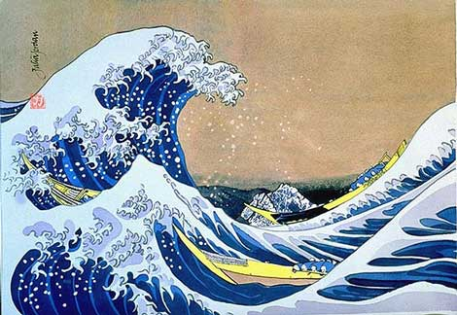
PEST Analysis
Ex. Electricity Utility: P. 26

Slide 30
Scenarios
Projections are basis of scenarios;
Scenario is NOT a forecast,
  Investigate implications of possible futures for the company – “What if”
  Short term issues – price reduction by a major competitor on:
    market share
    cash flow
    company’s profitability of matching the price reduction.
  Long term scenarios – much more speculative.

Slide 31
Scenarios
Create a picture of possible futures
Describe potential alternatives and acknowledge uncertainty
Strategy options can then be tested in each scenario
Provides rational for future positioning and options
True future can contain elemnets from each scenario
Must track and monitor
Critical to identify:
  Trends
  Discontinuities – it’s a trend until it bends!
    Do not expect future to be a continuation of the past

Slide 32
The Economy and Profitability
the likely impact of economic conditions on company operations:
Changes in Economic Activity
Sales
Competitive
Reactions
Costs
Purchasing
Power
Revenues
Inputs
Wages
Investment

Slide 33
The Economy and Profitability
It is possible for individual sectors of the economy to have a falling market size despite a relatively high level of growth in the economy as a whole.

Slide 34
The Economy and Profitability
Implications for Company Sales and Revenues
  Impact on Sales: depends on the responsiveness of the demand for that product to changes in GNP – GNP elasticity
    Elastic if: 1% change in GNP leads to > 1% change in demand and vice versa.
    Accuracy is impossible but a rough idea of the magnitude can be useful.
  Distribution of national expenditure among its components
    Ex: reduction in income tax, leads to an increase in disposable incomes and hence to consumption expenditure, may be accompanied by a reduction in government expenditure due to the end of the Cold War, the net effect of which is to leave GNP unchanged.
      Industries which rely on government expenditure on defence, such as the electronics industry, may find market size reduced,
      while those in consumer goods industries, such as TV sets, may find market size increased.

Slide 35
The Economy and Profitability
Competitive Reaction and the Economic Environment
  how competitors will behave in the light of the changing circumstances
  will they not react in the same way as our company?
  NOT aware of the economy and NOT predicting competitors reaction and behavior to it - combined effect could be catastrophic

Slide 36
The Economy and Profitability
Implications for Inputs and Company Costs
  input prices are likely to vary with the level of economic activity
  Wage rates in particular have a tendency to increase when the unemployment rate is low
  but not to decrease when the unemployment rate is high

Slide 37
Environmental Threat and Opportunity Profile: Part 1
method of systemizing how changes in the economic environment might relate to the company’s strategy.
  Threats
  Opportunities.
    Use all the tools (PEST, Scenarios, …)
    list the relevant environmental factors which have been identified
    Analyze impact whether positive or negative on:
      potential sales,
      costs,
      competitive response.
    Determine relative importance and rank;

Slide 38
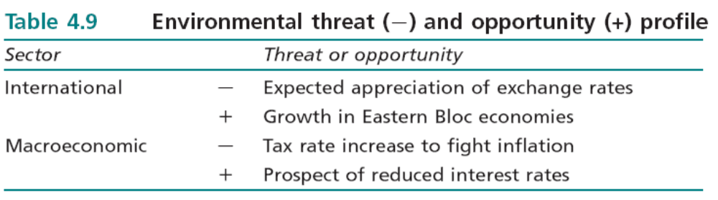
Environmental Threat and Opportunity Profile: Part 1
the mere incidence of pluses and minuses may give a misleading picture in the absence of some indication of the relative importance of the different factors
it may turn out that the positive entries are all potentially insignificant compared to the negative entries.
Ex. Health Food product is currently being sold in domestic and foreign markets.

Slide 39
Environmental Threat and Opportunity Profile: Part 1
International
THREAT: EXCHANGE RATE
Because of better trade figures and increased North Sea oil production it is estimated that the exchange rate will increase by about 10 per cent against currencies in the countries where the product is currently being sold.
Other things being equal, this will cause a 10 per cent increase in its price in these countries.
However, profit margins are already low and a reduction of 10 per cent in returns in order to hold the price at its current level will lead to losses on these sales.
OPPORTUNITY: EASTERN BLOC
Increased sales in the Eastern Bloc economies can be expected in the longer term;
however, these will constitute a relatively low proportion of total sales for the next five years.
Macroeconomic
THREAT: TAX RATE INCREASE
The recent tax rate increase will hit relatively affluent income groups hardest, and these comprise 90 per cent of the current market.
OPPORTUNITY: INTEREST RATE REDUCTION
Since health foods are not financed by loans the reduction in interest rates will have little effect on sales. However, reduced personal debt charges may help mitigate the effect of the tax increase.
THREATS > OPPORTUNITIES

Slide 40
